Slide 1

FOR PURPOSE OF FORAGE VIRTUAL INTERNSHIP PROGRAM
DATA EXPLORATION AND PREDICTION
19.12.2023

Slide 2
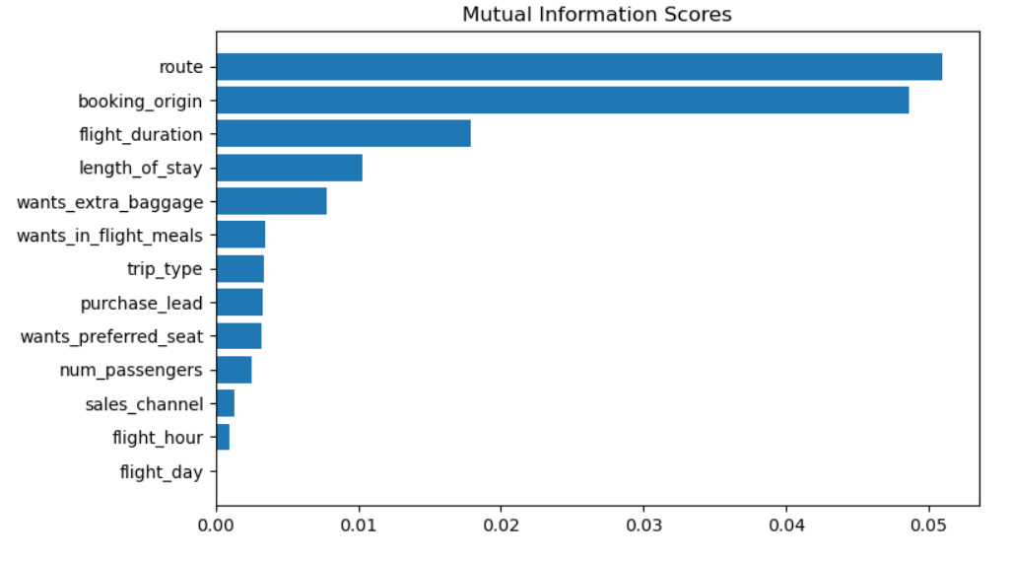
CUSTOMER BUYING BEHAVIOUR
RANDOM FOREST CLASSIFIER MODEL
MUTUAL INFORMATION SCORES
RANDOM FOREST CLASSIFIER MODEL PRODUCE AN ACCURACY RATE OF 80.08
MUTUAL INFORMATION MEASURES HOW MUCH KNOWING THE VALUE OF ONE VARIABLE REDUCES THE UNCERTAINTY ABOUT THE OTHER VARIABLE

